Slide 1


Lectures 9 pointer Dynamic memory
PROGRAMMING 1
(CS 102)
9
Fall (2025-2026)

Slide 2
Course Learning Objectives
Explain and define fundamental programming concepts, including variables, data types, the sequential nature of program execution, and basic program input/output (I/O).
Trace and debug simple programs to identify and correct basic syntax and logical errors.
Apply basic programing concepts, such as conditional statements, loops, and functions, to solve small scale computational problems.
Decompose problems into smaller, manageable subroutines, and implement basic functions to enhance code modularity and reusability.
Collaborate with peers Work in a team to design and implement a software project that meets specific functional requirements.

Slide 3

Lecture 9 : Pointer & Dynamic memory
Content
Pointer
Dynamic memory

Slide 4

Computer Memory
Each variable is assigned a memory slot (the size depends on the data type) and the variable’s data is stored there.
Memory address:
1020
1024
1032
…
…
100
…
1024
…
a
Variable a’s value, i.e., 100, is
stored at memory location 1024
int a = 100;

Slide 5
Pointers
A pointer is a variable used to store the address of a memory cell.
We can use the pointer to reference this memory cell.
integer
pointer
Memory address:
1020
1024
1032
…
…
100
…
1024
…
a
Variable a’s value, i.e., 100, is
stored at memory location 1024
int a = 100;

Slide 6

Create Pointer
A pointer can be declared in the same way as any other variable but with an asterisk symbol (*) as shown:
data_type* name
The data_type is the type of data that the pointer is pointing to.
The name is the name assigned to the pointer.
The * symbol is also called dereference operator.
Example:
int * ptr;
In the above statement, we create a pointer ptr that can store the address of an integer data.

Slide 7
Assign Address
The address of operator (&) determines the address of any variable in C++.
This address can be assigned to the pointer variable to initialize it.
Example:
int val = 22;
int* ptr = & val;
pointer ptr store the address of variable val using address-of operator (&).
The pointer and the variable should be of same type, Otherwise type mismatch error occurs.

Slide 8
Using pointers
int count = 5;
short status = 2;
char letter = 'A';
string s("ABC");
int* pCount;
short* pStatus;
char* pLetter;
string* pString;
pCount = &count;
pStatus = &status;
pLetter = &letter;
pString = &s;
count | 5
status | 2
letter | 'A'
s | "ABC"
Declare before use
pCount
pStatus
pLetter
pString
pCount | Address of count
pStatus | Address of status
pLetter | Address of letter
pString | Address of s
Address operator
// &status means address of status

Slide 9
Using pointers
int count = 5;
int* pCount = &count;
cout << "The value of count is " << count << endl;
cout << "The address of count is " << &count << endl;
cout << "The address of count is " << pCount << endl;
cout << "The value of count is " << *pCount << endl;
count++; // Direct reference to count
(*pCount)++; // Indirect reference to count (Dereferencing)
The value of count is 5
The address of count is 010FFE98
The address of count is 010FFE98
The value of count is 5
*pCount means the value pointed to by pCount

Slide 10

Don’t get confused
Two different tasks are represented with the same sign (*)
Declaring a pointer: int *p = &a;
Dereferencing a pointer: cout << (*p); // the value pointed to by p

Slide 11
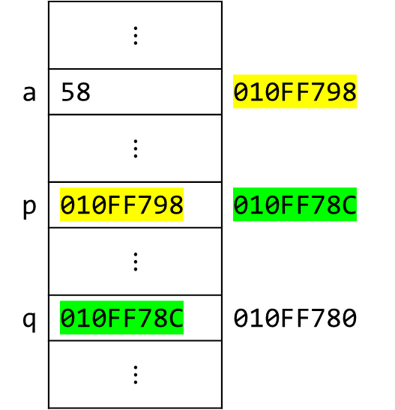
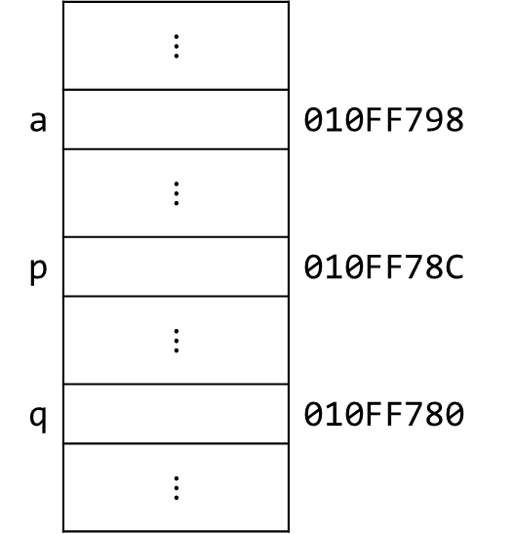
Pointer to Pointer
int a;//Integer
int* p;//Pointer
int** q;//Pointer to Pointer
a = 58;
p = &a;
q = &p;
cout << a << endl;
cout << p << endl;
cout << *p << endl;
cout << q << endl;
cout << *q << endl;
cout << **q << endl;
cout << &q << endl;
 | $$⋮$$
a | 58 | 010FF798
 | $$⋮$$
p | 010FF798 | 010FF78C
 | $$⋮$$
q | 010FF78C | 010FF780
 | $$⋮$$
 | $$⋮$$
a |  | 010FF798
 | $$⋮$$
p |  | 010FF78C
 | $$⋮$$
q |  | 010FF780
 | $$⋮$$
58
010FF798
58
010FF78C
010FF798
58
010FF780

Slide 12
Using pointers
It is a syntax error if the type of the variable does not match the type of the pointer.
int area = 1;
double* pArea = &area;
To prevent errors, you should always initialize pointers. An uninitialized pointer (a "wild pointer") points to a random memory address, which can lead to dangerous bugs.
double* pArea = 0;
double* pArea = NULL; // #define NULL 0
double* pArea = nullptr; // reserved pointer that does not point
to any valid memory location
if (!pArea) {... // This block will be executed if pArea is null
Notes:
Dereferencing a non initialized pointer may cause fatal runtime error or modify important data.

Slide 13

Using pointers
Declaring a pointer
double* pArea;
double *pArea;
double * pArea;
Declaring more than one pointer in one line
double* pArea, area; // A pointer and a double
double* pArea, *area; // Two pointers
!

Slide 14
What is the difference?
int x = 5;
int y = 6;
int* pX = &x;
int* pY = &y;
pX = pY;
int x = 5;
int y = 6;
int* pX = &x;
int* pY = &y;
*pX = *pY;

Slide 15
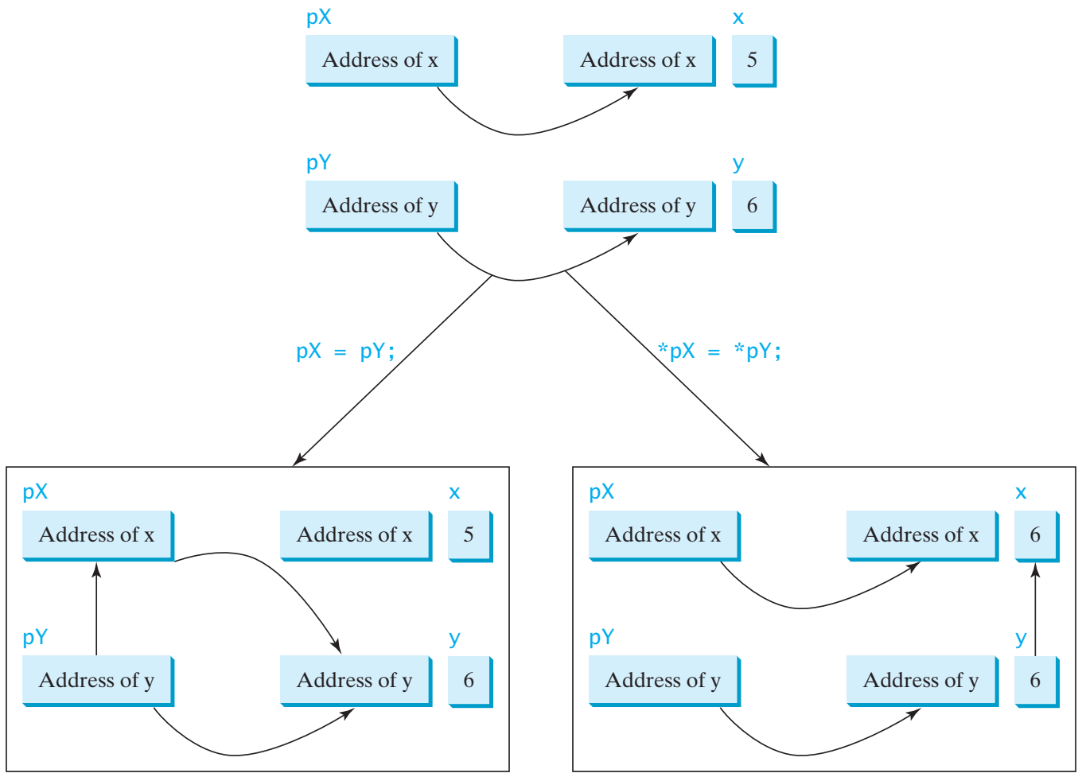

pX = pY;
*pX = *pY;

Slide 16
Example
int main()
{
int value1 = 5, value2 = 15;
int* p1, * p2;
p1 = &value1; // p1 = address of value1
p2 = &value2; // p2 = address of value2
*p1 = 10; // value pointed to by p1=10
*p2 = *p1; // value pointed to by p2= value
// pointed to by p1
p1 = p2; // p1 = p2 (pointer value copied)
*p1 = 20; // value pointed to by p1 = 20
cout << "value1==" << value1 << "/ value2==" << value2;
return 0;
}
value1==10 / value2==20

Slide 17


Which one should work? Why?
// Swap two variables using
void swap1(int n1, int n2)
{
int temp = n1;
n1 = n2;
n2 = temp;
}
// Swap two variables using
void swap3(int* p1, int* p2)
{
int temp = *p1;
*p1 = *p2;
*p2 = temp;
}
// Swap two variables using
// pass-by-value
void swap1(int n1, int n2)
{
int temp = n1;
n1 = n2;
n2 = temp;
}
// Swap two variables using
// pass by pointers
void swap3(int* p1, int* p2)
{
int temp = *p1;
*p1 = *p2;
*p2 = temp;
}
// Swap two variables using
void swap2(int& n1, int& n2)
{
int temp = n1;
n1 = n2;
n2 = temp;
}
// Swap two variables using
// pass-by-reference
void swap2(int& n1, int& n2)
{
int temp = n1;
n1 = n2;
n2 = temp;
}

Slide 18
Which one should work? Why?
// Swap two variables using
// pass-by-value
void swap1(int n1, int n2)
{
int temp = n1;
n1 = n2;
n2 = temp;
}
// Swap two variables using
// pass by pointers
void swap3(int* p1, int* p2)
{
int temp = *p1;
*p1 = *p2;
*p2 = temp;
}
int main()
{
int num1 = 1, num2 = 2;
swap1(num1, num2);
return 0;
}
int main()
{
int num1 = 1, num2 = 2;
swap3(&num1, &num2);
return 0;
}
// Swap two variables using
// pass-by-reference
void swap2(int& n1, int& n2)
{
int temp = n1;
n1 = n2;
n2 = temp;
}
int main()
{
int num1 = 1, num2 = 2;
int* p1 = &num1;
int* p2 = &num2;
swap3(p1, p2);
return 0;
}
int main()
{
int num1 = 1, num2 = 2;
swap2(num1, num2);
return 0;
}

Slide 19
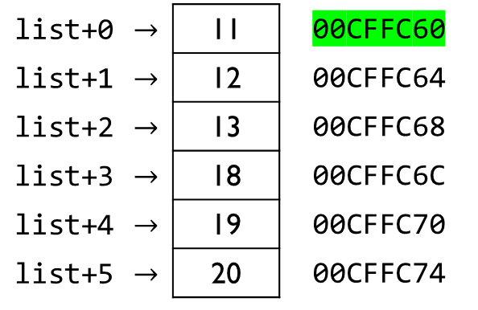
Arrays and Pointers
An array variable name is a pointer to the first element.
int list[6] = { 11, 12, 13, 18, 19, 20 };
cout << &list[0] << endl;
cout << list << endl;
cout << list[0] << endl;
cout << *list << endl;
cout << list[3] << endl;
cout << *(list+3) << endl;
list+0 | $$→$$ | 11 | 00CFFC60
list+1 | $$→$$ | 12 | 00CFFC64
list+2 | $$→$$ | 13 | 00CFFC68
list+3 | $$→$$ | 18 | 00CFFC6C
list+4 | $$→$$ | 19 | 00CFFC70
list+5 | $$→$$ | 20 | 00CFFC74
00CFFC60
00CFFC60
11
11
Is it the same as *list+3 ?
18
18

Slide 20
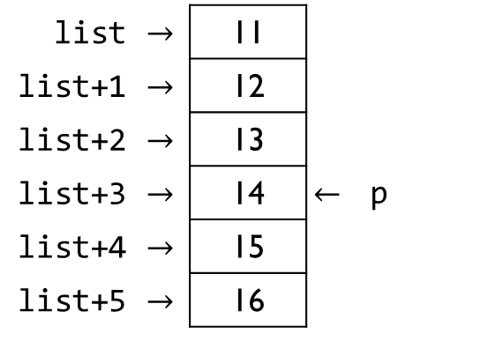
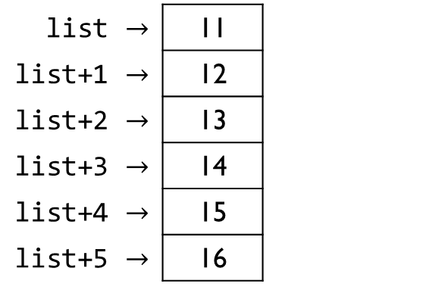
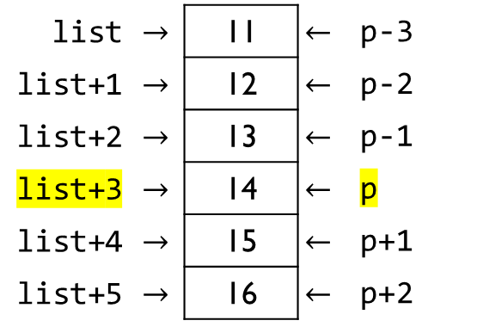
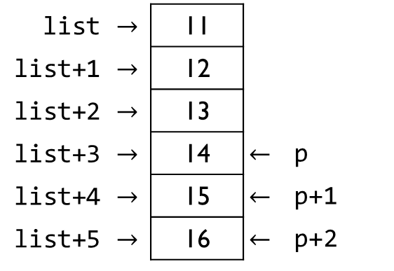
Arrays and Pointers
int list[] = { 11, 12, 13, 14, 15, 16 };
int* p = &list[3];
cout << list[0] << " " << p[-3] << endl;
cout << list[3] << " " << p[0] << endl;
cout << list[5] << " " << p[2] << endl;
cout << list[4] << " " << p[-1] << endl;
cout << list[3] << " " << p[3] << endl;
11 11
14 14
16 16
15 13
14 -858993460
list | $$→$$ | 11
list+1 | $$→$$ | 12
list+2 | $$→$$ | 13
list+3 | $$→$$ | 14
list+4 | $$→$$ | 15
list+5 | $$→$$ | 16
list | $$→$$ | 11 | $$←$$ | p-3
list+1 | $$→$$ | 12 | $$←$$ | p-2
list+2 | $$→$$ | 13 | $$←$$ | p-1
list+3 | $$→$$ | 14 | $$←$$ | p
list+4 | $$→$$ | 15 | $$←$$ | p+1
list+5 | $$→$$ | 16 | $$←$$ | p+2
list | $$→$$ | 11
list+1 | $$→$$ | 12
list+2 | $$→$$ | 13
list+3 | $$→$$ | 14 | $$←$$ | p
list+4 | $$→$$ | 15
list+5 | $$→$$ | 16
list | $$→$$ | 11
list+1 | $$→$$ | 12
list+2 | $$→$$ | 13
list+3 | $$→$$ | 14 | $$←$$ | p
list+4 | $$→$$ | 15 | $$←$$ | p+1
list+5 | $$→$$ | 16 | $$←$$ | p+2

Slide 21
Pointer to Array
A pointer to an array
int list[5] = { 9, 8, 7, 6, 5 };
int* p;
p = list;
p = &list[0];
p = &list[1];
p = list + 1;
p
list[0]
list[1]
list[2]
list[3]
list[4]
p

Slide 22
Using const with Pointers

Slide 23
Using const with Pointers
You can declare a constant pointer.
double radius = 5;
double* const pValue1 = &radius;
const double* pValue2 = &radius;
const double* const pValue3 = &radius;
constant data
constant pointer
Cannot change the address stored in the pointer
Cannot change the data using this pointer

Slide 24
Using const with Pointers
double radius = 5;
double length = 5;
double* const p1 = &radius;
*p1 = 6; // -------------------------->
p1 = &length; // --------------------->
const double* p2 = &radius;
*p2 = 6; // -------------------------->
p2 = &length; // --------------------->
const double* const p3 = &radius;
*p3 = 6; // -------------------------->
p3 = &length; // --------------------->
OK? | Wrong?
OK? | Wrong?
OK? | Wrong?

Slide 25

Dynamic memory

Slide 26
Dynamic Memory
Allows obtaining memory at runtime.
Why?
Amount of required data may be unknown at compile time
Efficient memory use:
Allocate as much as needed
Free when not needed

Slide 27

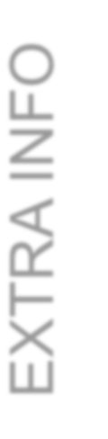




Memory Segments
EXTRA INFO
Code Segment | Fixed size |  | Program, Const (?)
Data Segment | Fixed size |  | Static, Global
Heap Bad Alloc exception | ⍖ | Growth | Dynamically allocated memory
Stack Overflow Stack | ⍏ | Growth | Temporary storage Statically allocated memory

Slide 28
Dynamic Memory Allocation / Deallocation
The Allocation Process (new) int * pInt;
pInt = new int;
int *pInt;: A pointer variable is created on the Stack.
pInt = new int;: The new keyword is the request. It finds a free spot on the Heap, reserves it, and returns the memory address.
The pointer pInt (on the Stack) now holds the address of the memory block (on the Heap).
pInt
Address
0000
pItt
Utititialized
Utititialized itt
Stack
Heap

Slide 29
Dynamic Memory Allocation / Deallocation
The Deallocation Process (delete)
delete pInt;: This tells the computer, "I am done with this Heap memory." The memory block is freed up (shown as 000 or greyed out) so other parts of the program can use it.
Crucial Note: At this exact moment, pInt typically still holds the address of that freed memory. This is dangerous! ----------> solution ----------> pInt = nullptr;
pInt
0
ooo
pItt
UtitDaAdngitiadrliesnglizs!!ed
Utititialize10 d itt
Stack
Heap

Slide 30
Dynamic Memory Allocation / Deallocation
int x; x = 2;
Allocate in
heap
pInt
Address
10
int *pInt ; pInt = new int;
*pInt = 10;
Deallocate
from heap
delete pInt; pInt = nullptr;
pItt
Utititialized
Utititialized itt
x
2
Uninitialized
Stack
Heap
pInt
0
ooo
pItt
UtitDaAdngitiadrliesnglizs!!ed
Utititialize10 d itt
x
2
Uninitialized
Stack
Heap
Prevent "dangling pointers," which are pointers that point to deallocated memory

Slide 31
Dynamic Memory Allocation/Deallocation
int* p1 = new int; // Allocate
delete p1; // Deallocate
int* pInt ;
pInt = new int;
*pInt = 10;
delete pInt;
int* newList = new int[6]; // Allocate
delete[] newList; // Deallocate
Undefined pointer
Uninitialized pointer
Uninitialized int variable
X
pInt
10
Can be a variable!

Slide 32
Dynamic Memory Allocation / Deallocation
int* p1 = new int; // Allocate in heap delete p1; // Deallocate from heap
int* newList = new int[6]; // Allocate
delete[] newList; // Deallocate

Slide 33
Static vs. Dynamic Memory
Static Memory Allocation
Memory is allocated at compilation time
Dynamic Memory
Memory is allocated at running time

Slide 34



